Slide 1
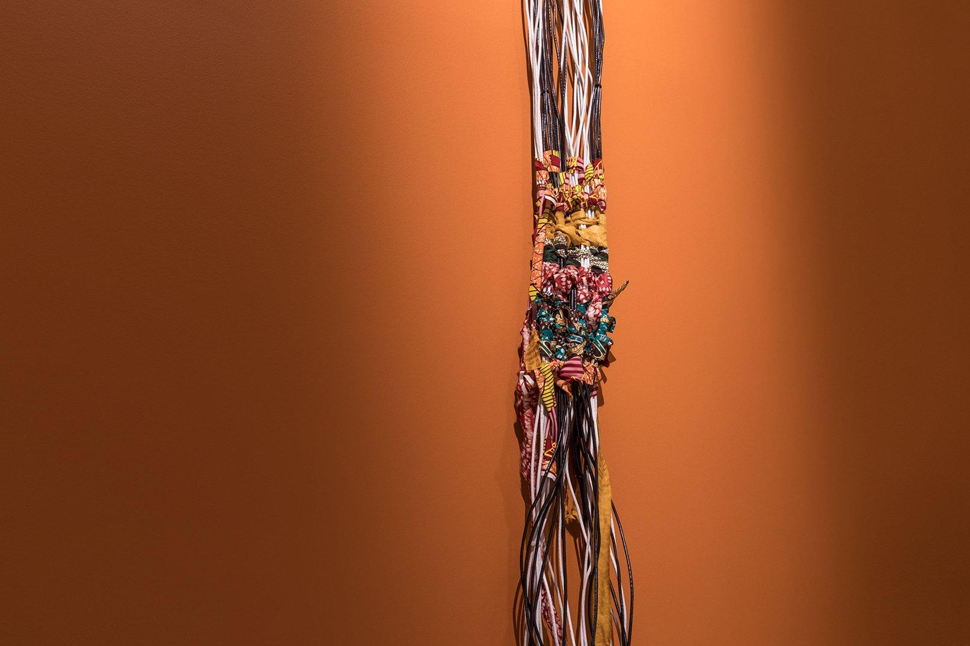
Mimi Ọnụọha
‘/Me-Me Ah-No-Oo-Hwa/’
Multimedia Artist/Researcher
Notes:
Image of The Hair in the Cable by Mimi

Slide 2
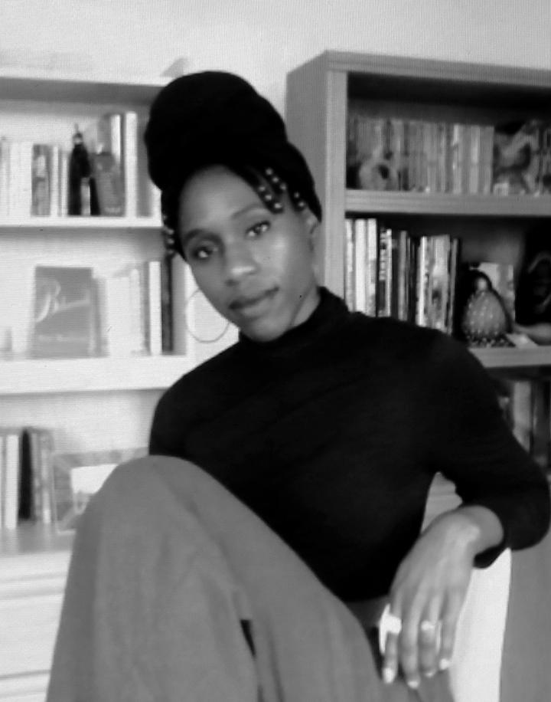
Who is she?
Nigerian-American artist and academic based out of Brooklyn, NY
Has been the artist in residency at:
Eyebeam Center for Art & Technology
Studio XX
Data & Society Research Institute
Tow Center
Royal College of Art
Focus is on the way people aren’t represented in data driven systems
Currently an adjunct professor at New York University

Slide 3
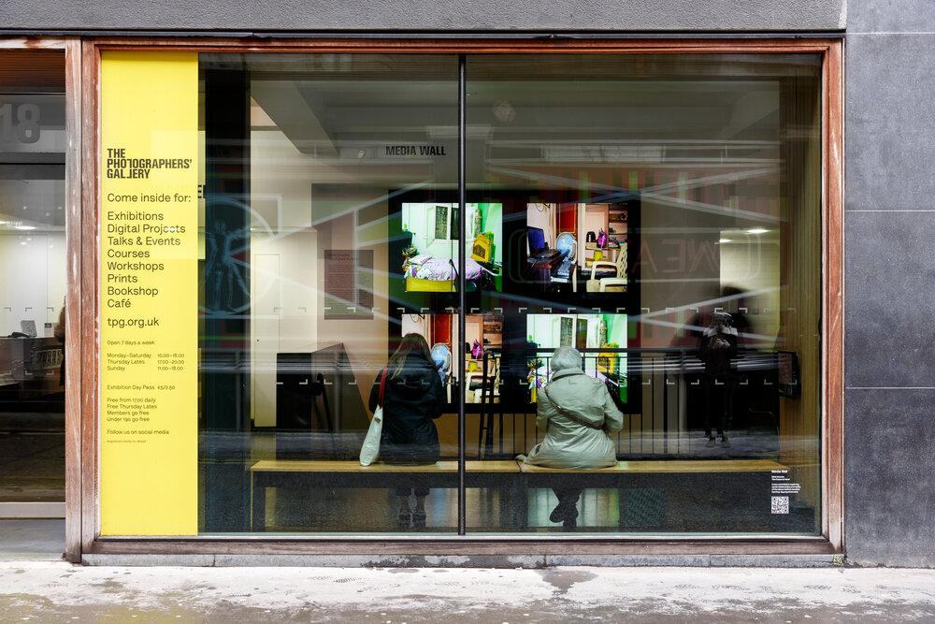

What does she do?
Work looks to point out the human element in data sets, both present and missing
Believes public discussion about the development of AI is important
Works include exhibitions/installations, as well as writing, lectures, and teaching
Notes:
Data Sets
Points out the human cost data sorting through websites such as the mechanical turk or Figure Eight
These humans have to manually catalog data for sorting by AI
Public Discussion on AI
Mimi (correctly) believes the public does not know the true cost of AI
Mimi hopes her art will translate some of those costs into a medium non-AI-educated folks can understand

Slide 4
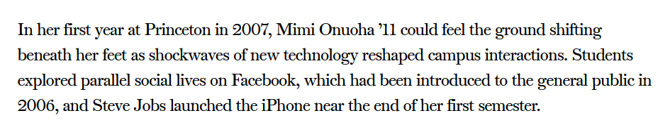
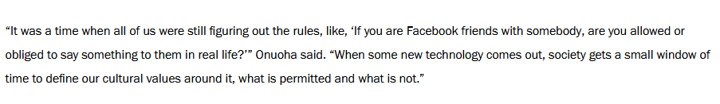
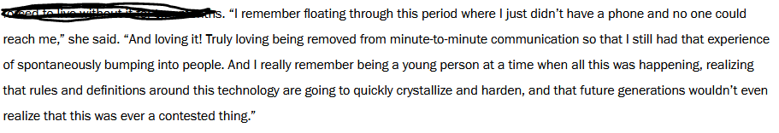
Why does she do it?
(Excerpt from Princeton University Alumni website)

Slide 5
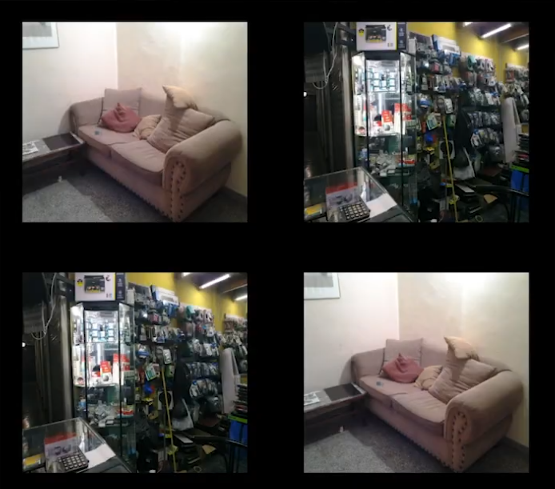
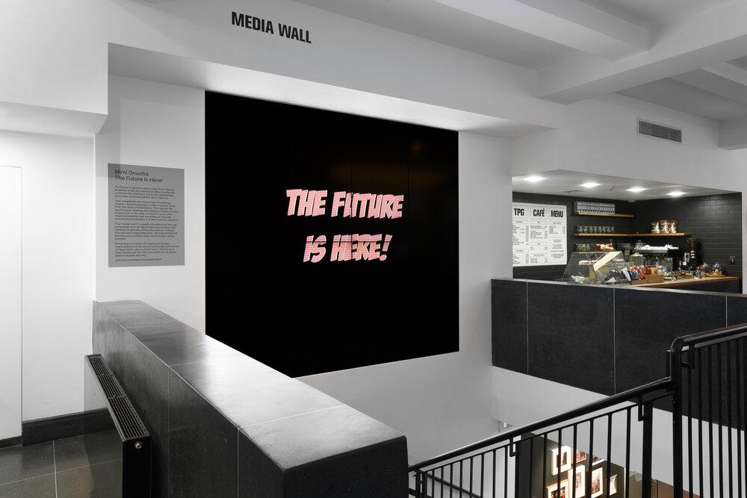
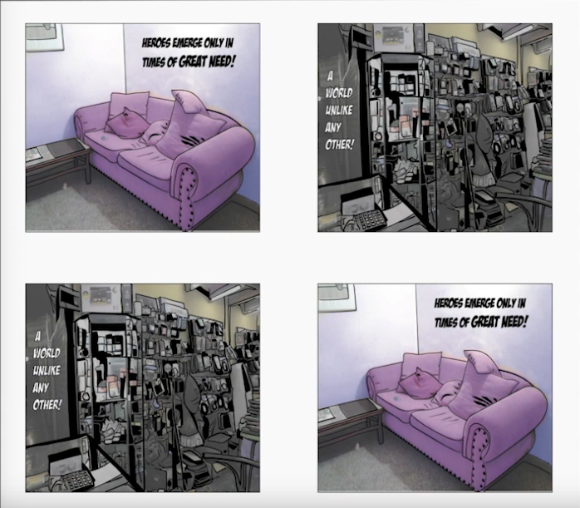
The Future is Here! (2019)
Notes:
Asks people on Future Eight to take pictures of their working spaces
She then draws them into something brighter in an attempt to add a “tenderness” (her word) to them
The idea is to allow people to think about what the future might look like for us in this data driven world

Slide 6
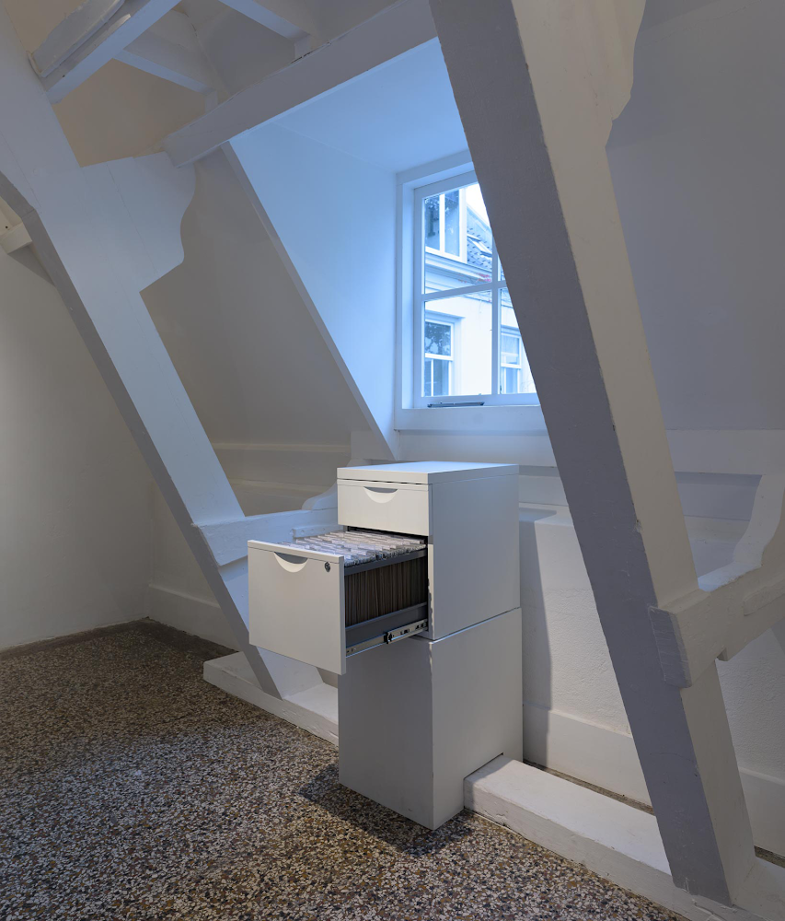
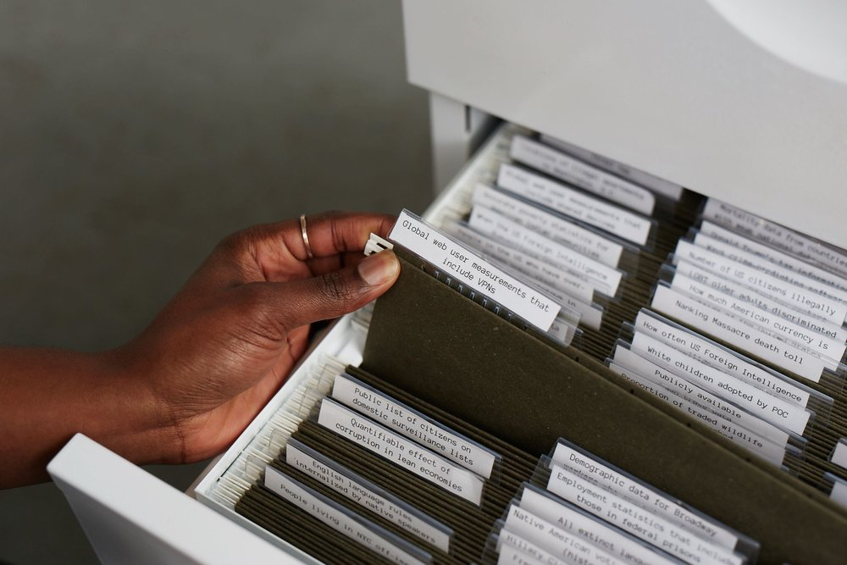
The Library of Missing Datasets (2016)

Slide 7
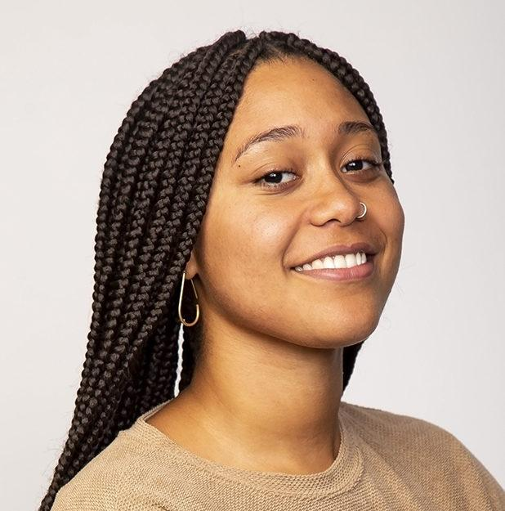
Linda Dounia Rebeiz
Artist and designer
Investigates philosophical implications of technocapitalism and its role in inequity
Combination of analogue and digital mediums
Inspired by science fiction, speculative design, solarpunk, and degrowth philosophies
Recognized on the TIMEAI100 list of most influential people in AI in 2023

Slide 8

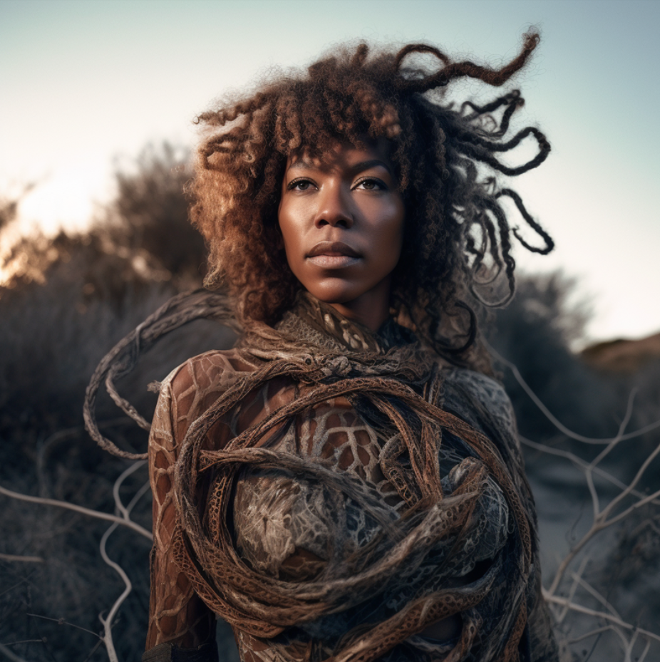


Pigeonholes, Study 2022-
Series experimenting with Midjourney
Tries to recreate iconic science fiction characters, such as those in Octavia Butler's Xenogenesis series
Results: Come across many biases and stereotypes.

Slide 9
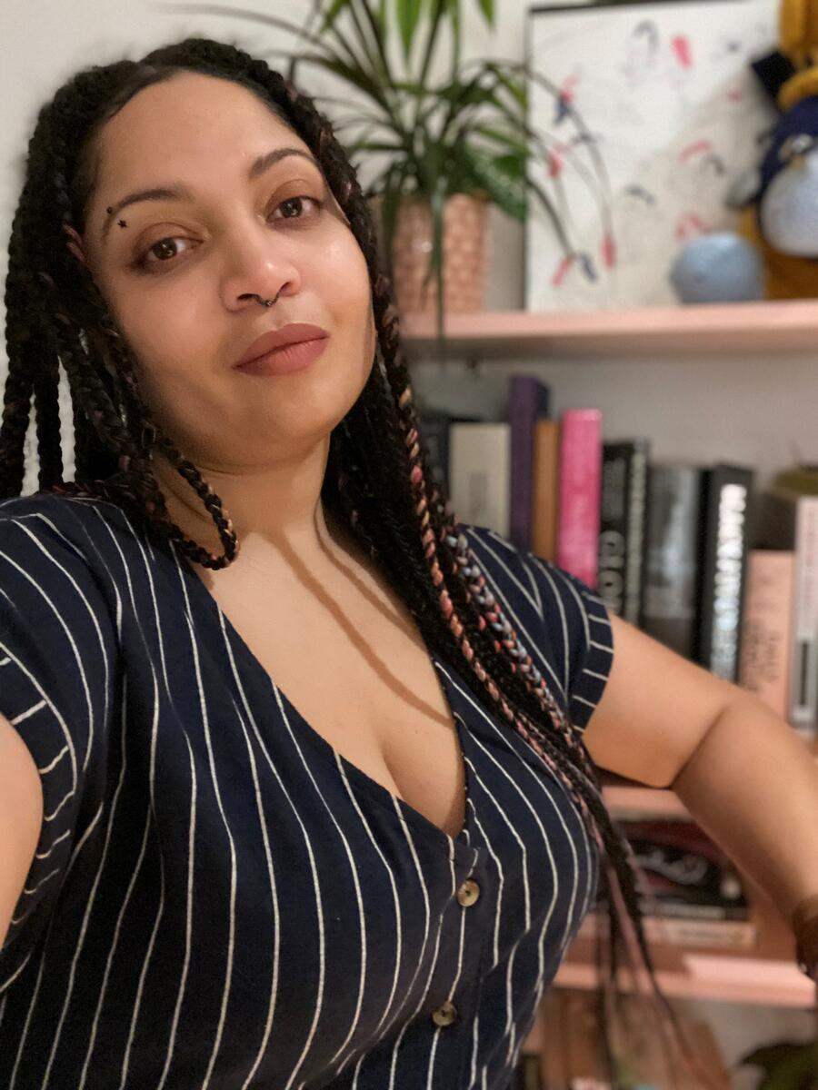
A.M. Darke
Artist and scholar designing radical tools for social intervention
Associate Professor in Digital Arts and New Media, Critical Race and Ethnic Studies, and Performance, Play & Design at UC Santa Cruz, and directs The Other Lab, an interdisciplinary, intersectional feminist research space for experimental games, XR, and new media
Holds a B.A. in Design and an M.F.A. in Media Arts, both from UCLA
Completed residencies (e.g.,NYU Game Center)

Slide 10
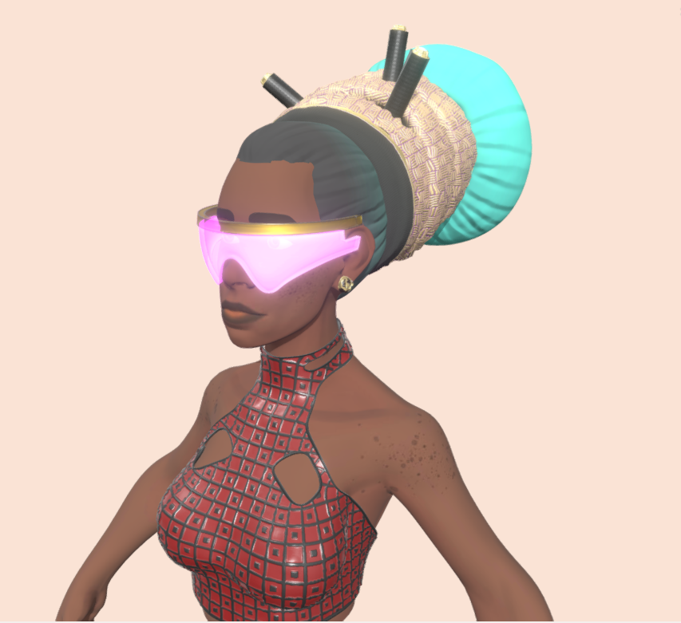
OPEN SOURCE AFRO HAIR LIBRARY 2020-
Free,user-friendly,Feminist,anti-racist, highly curated 3D model database of Black hairstyles and textures
Address the lack of thoughtful representation of Blackness in games, virtual/augmented reality,3D asset marketplaces and other 3D media
Two main issues on 3D asset marketplaces:
How does one search effectively for “Black hair”?
The quality of the results

Slide 11
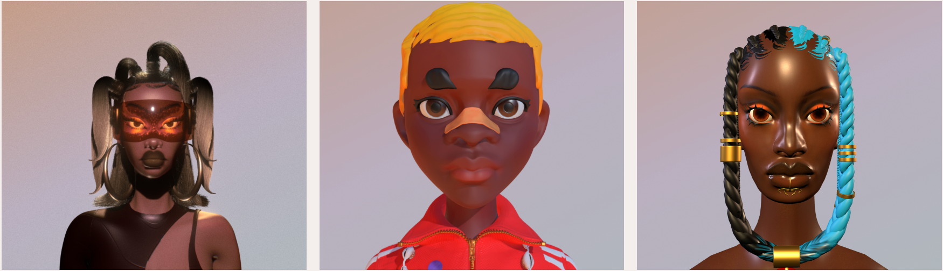

Slide 12

Stefanie Posavec
Designer, artist,conceptual consultant, teacher and author exploring experimental approaches to communicating data and information to all ages and audiences
Wearable projects using a human-scaled, hand-crafted design process
Sketch data visualisation for research teams, create artworks for campaigns, design colour books, do conferences, do workshops

Slide 13
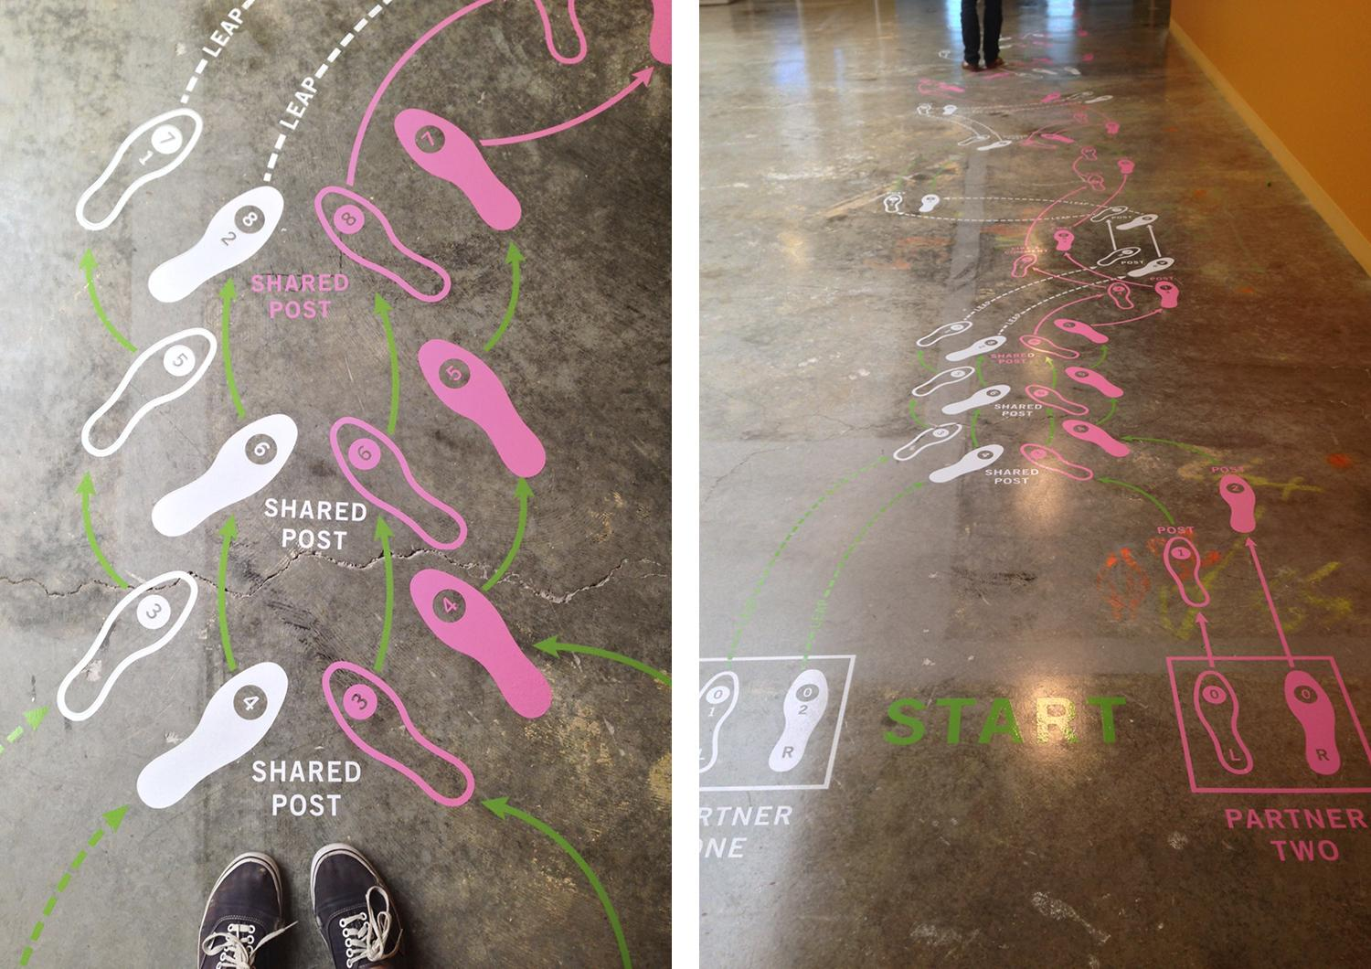
Facebook Art Residency: Relationship Dance Steps
Two interactive pieces on the floor where I converted a month of a couple’s Facebook interaction data into dance steps, referencing how couples often ‘perform’ an orchestrated, public version of their relationship on social media
Passerby can move through an accurate representation of a couple’s digital movements and interactions in the real world

Slide 14
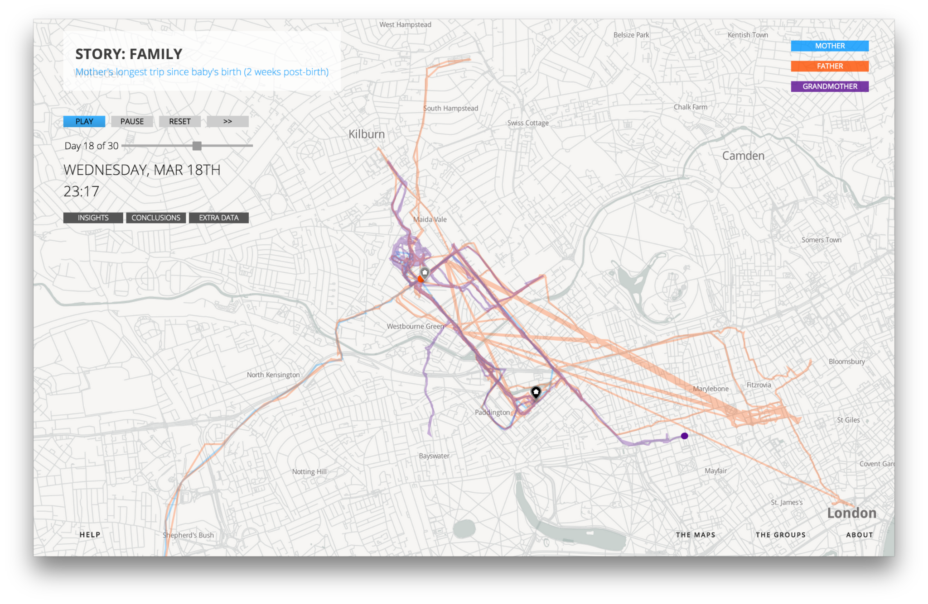
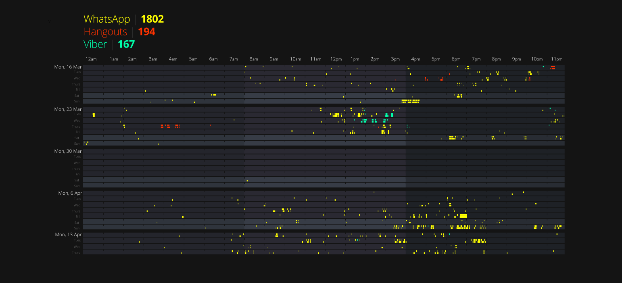
Pathways
Data storytelling project
Present a month's worth of geolocation data and message metadata collected from the mobile phones of four groups: a couple, a set of co-workers, a family, and roommates
Aim to show what digital data looks like in the context of common relationships

Slide 15
Questions
Name some highly specific data set we likely DO NOT have
What is the type of data that, as of current, we would have NO WAY of categorizing? And what potential problems could arise from this?
Do you think the current model for data sorting (such as labelling) is sustainable for a living?

Slide 16
Cass Bibliography
“About | Pathways Project.” Accessed September 17, 2023.
https://www.nationalgeographic.com/pathways/about.html.
MIMI ỌNỤỌHA. “Pathways — MIMI ỌNỤỌHA.” Accessed September 17, 2023. https://mimionuoha.com/pathways.
“Open Source Afro Hair Library.” Accessed September 17, 2023. https://afrohairlibrary.org>.
prettydarke. “Bio,” November 15, 2015. https://prettydarke.cool/bio/.
prettydarke. “Open Source Afro Hair Library,” April 24, 2020. https://prettydarke.cool/portfolio/open-source-afro-hair-library/.
Stefanie Posavec. “Facebook Art Residency: Relationship Dance Steps.” Accessed September 17, 2023.
https://www.stefanieposavec.com/facebook-art-residency-relationship-dance-steps.
Stefanie Posavec. “Stefanie Posavec.” Accessed September 17, 2023. https://www.stefanieposavec.com.
Linda Dounia Rebeiz.”About.”Accessed September 17, 2023. https://lindarebeiz.com/about/.
Linda Dounia Rebeiz.”Prompt.”Accessed September 17, 2023. https://lindarebeiz.com/prompt/.

Slide 17
Mads Bibliography
‘About — MIMI ỌNỤỌHA’, MIMI ỌNỤỌHA <https://mimionuoha.com/about> [accessed 18 September 2023]
‘Making Audacious Bets on the Future of Technology: Media Artist Mimi Onuoha ’11 Shines a Light into the Invisible Margins of Data | Princeton Alumni’ <https://alumni.princeton.edu/stories/mimi-onuoha-reimagining-data> [accessed 18 September 2023]
‘Mimi Onuoha’, Data & Society <https://datasociety.net/people/onuoha-mimi/> [accessed 18 September 2023]
‘The Cloth In The Cable — MIMI ỌNỤỌHA’, MIMI ỌNỤỌHA <https://mimionuoha.com/in-the-cable> [accessed 18 September 2023]
‘The Future Is Here! — MIMI ỌNỤỌHA’, MIMI ỌNỤỌHA <https://mimionuoha.com/the-future-is-here> [accessed 18 September 2023]
The Future Is Here! An Interview with Mimi Onuoha, dir. by The Photographers’ Gallery, 2020 <https://www.youtube.com/watch?v=er8n14cnAo4> [accessed 18 September 2023]
‘The Library of Missing Datasets — MIMI ỌNỤỌHA’, MIMI ỌNỤỌHA <https://mimionuoha.com/the-library-of-missing-datasets> [accessed 18 September 2023]

